Slide 1

KNOWLEDGE
UNITY & DISCIPLINE
CHARACTER
MASTERMINDS
COLLEGE’S NAME: NMIT POLYTECHNIC
Student’s DETAIL: NAME: Nadimicherla reddy kumar REG.NO: 568CS21025

Slide 2

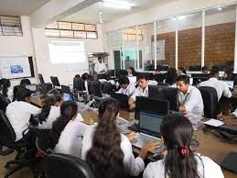
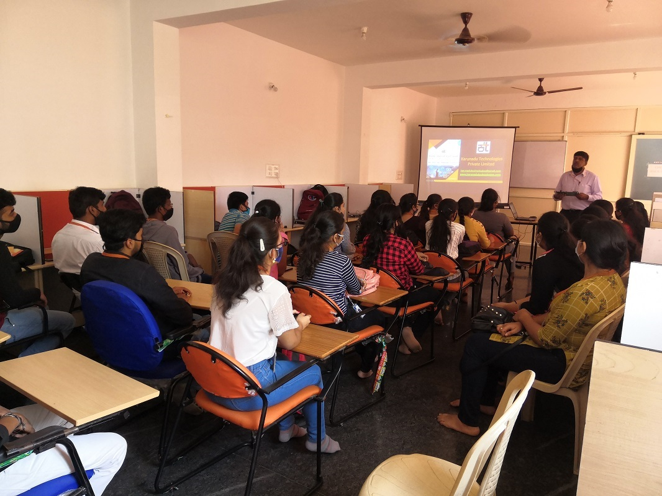
RESEARCH
INTERNSHIPS
PROJECTS
WORKSHOPS
KARUNADU TECHNOLOGIES PRIVATE LIMITED
INTERNSHIP CARRIED OUT AT KARUNADU TECHNOLOGIES PRIVATE LIMITED

Slide 3
TOPICS LEARNED DURING INTERNSHIP
LOGISTIC REGRESSION
SVM(SUPPORT VECTOR MACHINE)
MULTIPLE LINEAR REGRESSION
KNN(K-NEAREST NEIGHBOUR)
RANDOM FOREST METHOD
INTRODUCTION TO AI & ML
BASICS IN PYTHON(STR,DICT,LIST,TUP,ETC
INSTALLATION OF ANACONDA PROMPT
USE OF JUPYTER NOTEBOOK
LINEAR REGRESSION AND MULTIPLE LR

Slide 4
Topic: Cirrhosis stage detection using Logistic Regression
Project no.1

Slide 5
Logistic regression
Logistic regression is a statistical method used for binary classification, which is a type of supervised machine learning technique.
It is named after the logistic function and it uses to model the probability of a binary outcome.
Logistic regression is a widely used algorithm in various fields

Slide 6
These are the steps to follow Cirrhosis stage detection using Logistic Regression
DATA COLLECTION AND PREPROCESSING:
FEATURE SELECTION:
LOGISTIC REGRESSION MODEL:
MODEL TRAINING:
MODEL EVALUATION:
MODEL INTERPRETATION:
THRESHOLD SELECTION:
PREDICTIONS:
MODEL VALIDATION:
DEPLOYMENT:

Slide 7
DATASETS USED AS INPUTS AND OUTPUT
ID
N_Days
Status
Drug
Age
Sex
Ascites
Hepatomegaly
Spiders
Edema
Bilirubin
Cholesterol
Albumin
Copper
Alk_Phos
SGOT

Slide 8
OUTPUTS:
Stage

Slide 9
STEPS FOLLOWED DURING CODING:
First, import pandas as pd.
Then, read the path and print the data and data.info.
Then use the fillna method.
Then, import sklearn, from sklearn.preprocessing, LabelEncoder.
Then, input X,y.
Then, from sklearn.model_selection import train_test_split, print(X_train,y_train,X_test,y_test).
Then, from sklearn.linear_model import LogisticRegression.
Then, fitting the model, printing y_pred and y_test.
Then, from sklearn.matrics import accuracy_score and classification report.
Then,calculating the accuracy and printing it.
Then, calculating the report and printing it.

Slide 10
CODE
import pandas as pd
path="C:\\Users\\Kumar R\\OneDrive\\Documents\\Downloads\\cirrhosis.csv"
data=pd.read_csv(path)
#print(data)
#print(data.info())
data=data.fillna(method='ffill')
#print(data)
print(data.info())
# using preprocessing technique..
import sklearn
from sklearn.preprocessing import LabelEncoder
le=LabelEncoder()
data.Status=le.fit_transform(data.Status)
data.Drug=le.fit_transform(data.Drug)
data.Sex=le.fit_transform(data.Sex)
data.Ascites=le.fit_transform(data.Ascites)
data.Hepatomegaly=le.fit_transform(data.Hepatomegaly)
data.Spiders=le.fit_transform(data.Spiders)
data.Edema=le.fit_transform(data.Edema)
print(data,'\n')
print(data.info())

Slide 11

# separating inp and out
inp=data.drop('Stage','columns')
out=data['Stage']
print('...INPUT DATA...')
print(inp,'\n')
print('...OUTPUT DATA...')
print(out)
from sklearn.model_selection import train_test_split
x_train,x_test,y_train,y_test=train_test_split(inp,out,train_size=0.8)
print(x_train)
print(x_test)
print(y_train)
print(y_test)
from sklearn.linear_model import LogisticRegression
model=LogisticRegression()
model.fit(x_train,y_train)
y_pred=model.predict(x_test)
print(y_pred)
print(y_test)# for comparision

Slide 12
N_Days=input("enter the n_days")
sta=int(input("enter the satus"))
dru=int(input("enter the drug"))
age=int(input("enter the age"))
sex=int(input("enter the sex"))
asc=int(input("enter the ascites"))
hep=int(input("enter the hepatomegaly"))
spi=int(input("enter the spiders"))
ede=int(input("enter the edema"))
bil=int(input("enter the bilirubin"))
cho=int(input("enter the cholesterol"))
alb=int(input("enter the albumin"))
cop=int(input("enter the copper"))
alk=int(input("enter the alk_phos"))
sgot=int(input("enter the sgot"))
tryg=int(input("enter the tryglicerides"))
plat=int(input("enter the platelets"))
pro=int(input("enter the prothrombin"))
print(model.predict([[Id,N_Days,sta,dru,age,sex,asc,hep,spi,ede,bil,cho,alb,cop,alk,sgot,tryg,plat,pro]]))
#from sklearn.metrics import accuracy_score, classification_report
accuracy = accuracy_score(y_test, y_pred)
print("Accuracy:", accuracy)
report = classification_report(y_test, y_pred)
print("Classification Report:\n", report)

Slide 13
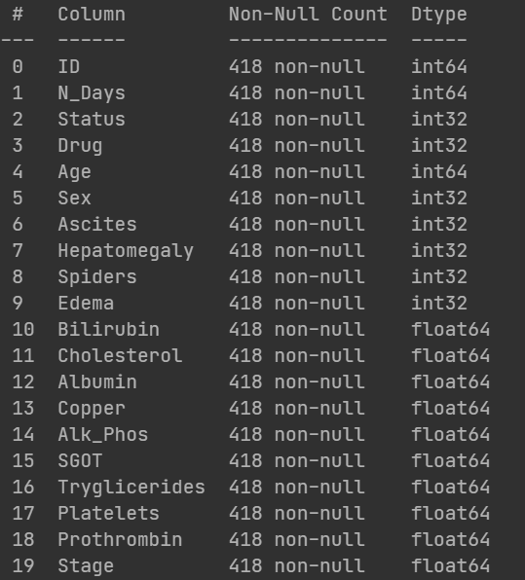
DATASETS USED

Slide 14
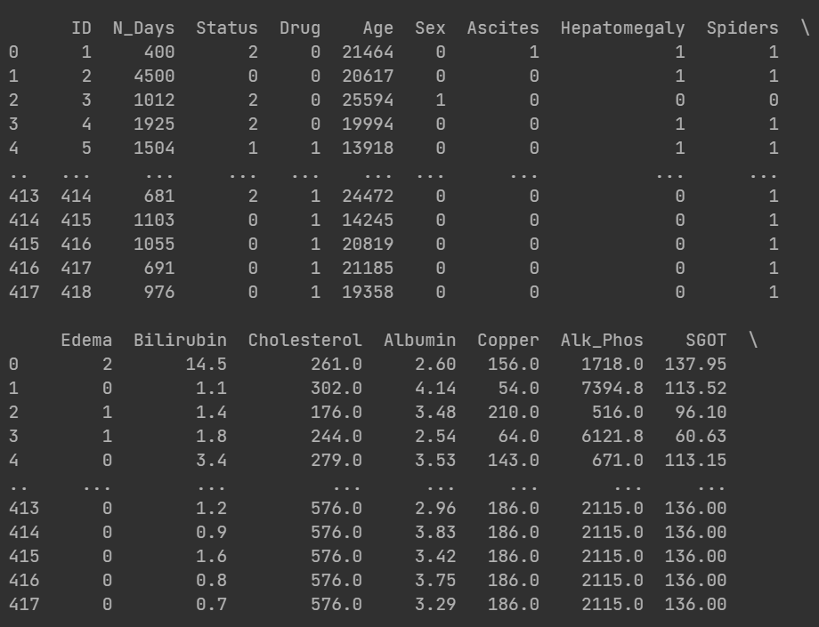
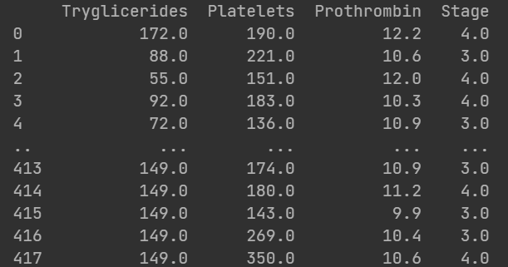
NUMBER OF ROWS AND COLUMNS OF DATASETS

Slide 15
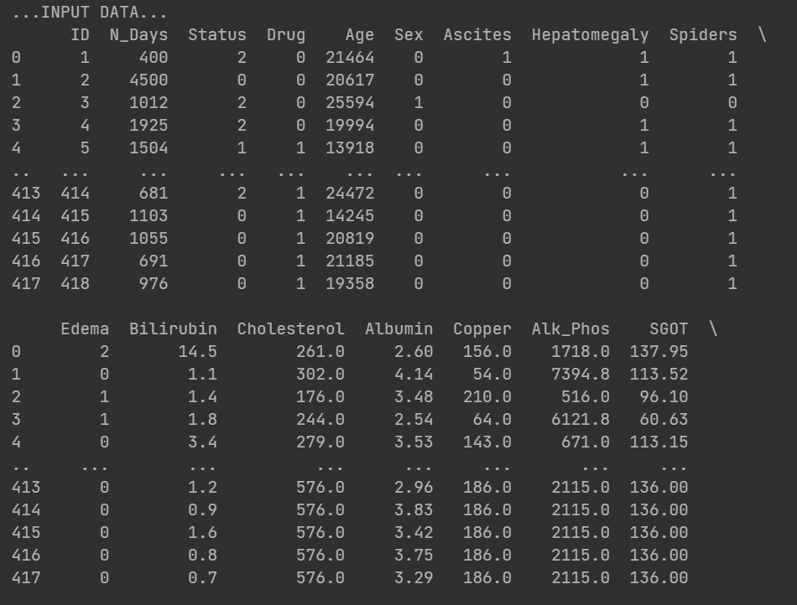
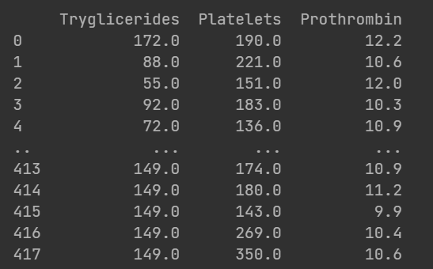
Input data

Slide 16
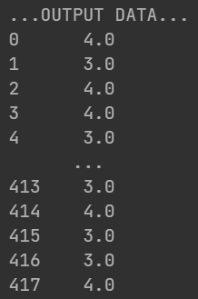
Output

Slide 17
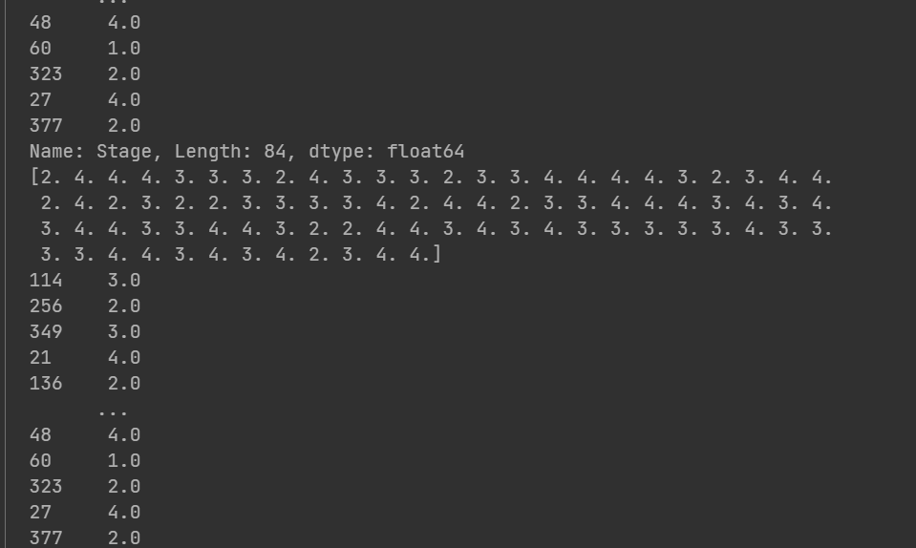
PREDICTED RESULT

Slide 18
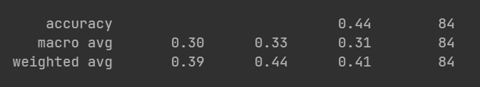
ACCURACY SCORE

Slide 19
NMIT POLYTECHNIC
KARUNADU TECHNOLOGIES PRIVATE LIMITED

Slide 20
INTERNSHIP CARRIED OUT AT KARUNADU TECHNOLOGIES PRIVATE LIMITED
STUDENTS’S SEMESTER:5TH SEM
COLLEGE NAME:NMIT POLYTECHNIC

Slide 21
THANKING YOU
YOUR SINCERELY,
NADIMICHERLA REDDY KUMAR
01/10/2023
MAIL: nadimicherlareddykumar@gmail.com
PH.NO: 8217491156

